Slide 1
Convolutional Neural Networks

Slide 2
Motivation

Slide 3

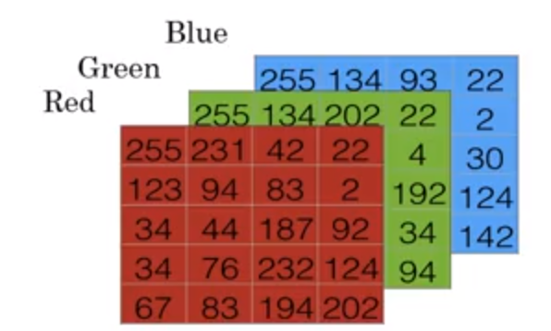
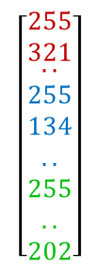

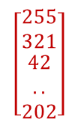
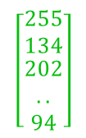

Image representation (hitherto approach)
1 (cat)
0 (not cat)
$$\left[\begin{matrix}255 \\ 321 \\ \begin{aligned}.. \\ 255 \\ 134 \\ .. \\ 255 \\ .. \\ 202\end{aligned}\end{matrix}\right]$$
$$\left[\begin{matrix}255 \\ 134 \\ \begin{aligned}93 \\ .. \\ 142\end{aligned}\end{matrix}\right]$$
$$\left[\begin{matrix}255 \\ 134 \\ \begin{aligned}202 \\ .. \\ 94\end{aligned}\end{matrix}\right]$$
Model
$$y=\left\{0,1\right\}$$
$$\left[\begin{matrix}255 \\ 321 \\ \begin{aligned}42 \\ .. \\ 202\end{aligned}\end{matrix}\right]$$

Slide 4
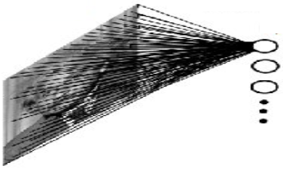
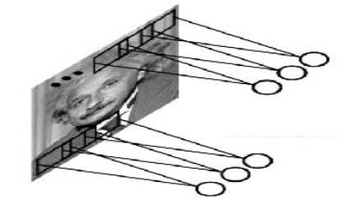


Image representation - problems
$$\left[\begin{matrix}255 \\ 321 \\ \begin{aligned}.. \\ 255 \\ 134 \\ .. \\ 255 \\ .. \\ 202\end{aligned}\end{matrix}\right]$$
Too many weights → too complicated model
It is difficult to generalise learned features over the entire image
Solving these two problems is the main motivation for Convolutional Neural Networks
Model
$$y=\left\{0,1\right\}$$

Slide 5
CNN Basics

Slide 6
Convolution Operation
Convolution
Image
8 | 6 | 2 | 1 | 0 | 3
7 | 4 | 2 | 4 | 4 | 8
3 | 1 | 0 | 8 | 3 | 4
5 | 1 | 3 | 6 | 1 | 5
9 | 6 | 0 | 3 | 2 | 4
6 | 8 | 2 | 9 | 4 | 7
Filter
*
=

Slide 7
Convolution Operation
8 | 6 | 2 | 1 | 0 | 3
7 | 4 | 2 | 4 | 4 | 8
3 | 1 | 0 | 8 | 3 | 4
5 | 1 | 3 | 6 | 1 | 5
9 | 6 | 0 | 3 | 2 | 4
6 | 8 | 2 | 9 | 4 | 7
1 | 0 | -1
1 | 0 | -1
1 | 0 | -1
*
=

Slide 8
Convolution Operation
8 ¹ | 6 ⁰ | 2 ⁻¹ | 1 | 0 | 3
7 ¹ | 4 ⁰ | 2 ⁻¹ | 4 | 4 | 8
3 ¹ | 1 ⁰ | 0 ⁻¹ | 8 | 3 | 4
5 | 1 | 3 | 6 | 1 | 5
9 | 6 | 0 | 3 | 2 | 4
6 | 8 | 2 | 9 | 4 | 7
1 | 0 | -1
1 | 0 | -1
1 | 0 | -1
*
=

Slide 9
Convolution Operation
8 * 1 + 7 * 1 + 3 * 1 + 6 * 0 + 4 * 0 + 1 * 0 + 2 * (-1) + 2 * (-1) + 2 * (-1) = 14
8 ¹ | 6 ⁰ | 2 ⁻¹ | 1 | 0 | 3
7 ¹ | 4 ⁰ | 2 ⁻¹ | 4 | 4 | 8
3 ¹ | 1 ⁰ | 0 ⁻¹ | 8 | 3 | 4
5 | 1 | 3 | 6 | 1 | 5
9 | 6 | 0 | 3 | 2 | 4
6 | 8 | 2 | 9 | 4 | 7
14
1 | 0 | -1
1 | 0 | -1
1 | 0 | -1
*
=

Slide 10
Convolution Operation
6 * 1 + 4 * 1 + 1 * 1 + 2 * 0 + 2 * 0 + 0 * 0 + 1 * (-1) + 4 * (-1) + 8 * (-1) = -2
8 | 6 ¹ | 2 ⁰ | 1 ⁻¹ | 0 | 3
7 | 4 ¹ | 2 ⁰ | 4 ⁻¹ | 4 | 8
3 | 1 ¹ | 0 ⁰ | 8 ⁻¹ | 3 | 4
5 | 1 | 3 | 6 | 1 | 5
9 | 6 | 0 | 3 | 2 | 4
6 | 8 | 2 | 9 | 4 | 7
14 | -2
1 | 0 | -1
1 | 0 | -1
1 | 0 | -1
*
=

Slide 11
Convolution Operation
2 * 1 + 2 * 1 + 0 * 1 + 1 * 0 + 4 * 0 + 8 * 0 + 0 * (-1) + 4 * (-1) + 3 * (-1) = -3
8 | 6 | 2 ¹ | 1 ⁰ | 0 ⁻¹ | 3
7 | 4 | 2 ¹ | 4 ⁰ | 4 ⁻¹ | 8
3 | 1 | 0 ¹ | 8 ⁰ | 3 ⁻¹ | 4
5 | 1 | 3 | 6 | 1 | 5
9 | 6 | 0 | 3 | 2 | 4
6 | 8 | 2 | 9 | 4 | 7
14 | -2 | -3
1 | 0 | -1
1 | 0 | -1
1 | 0 | -1
*
=

Slide 12
Convolution Operation
1 * 1 + 4 * 1 + 8 * 1 + 0 * 0 + 4 * 0 + 3 * 0 + 3 * (-1) + 8 * (-1) + 4 * (-1) = -2
8 | 6 | 2 | 1 ¹ | 0 ⁰ | 3 ⁻¹
7 | 4 | 2 | 4 ¹ | 4 ⁰ | 8 ⁻¹
3 | 1 | 0 | 8 ¹ | 3 ⁰ | 4 ⁻¹
5 | 1 | 3 | 6 | 1 | 5
9 | 6 | 0 | 3 | 2 | 4
6 | 8 | 2 | 9 | 4 | 7
14 | -2 | -3 | -2
1 | 0 | -1
1 | 0 | -1
1 | 0 | -1
*
=

Slide 13
Convolution Operation
7 * 1 + 3 * 1 + 5 * 1 + 4 * 0 + 1 * 0 + 0 * 0 + 2 * (-1) + 0 * (-1) + 3 * (-1) = 10
8 | 6 | 2 | 1 | 0 | 3
7 ¹ | 4 ⁰ | 2 ⁻¹ | 4 | 4 | 8
3 ¹ | 1 ⁰ | 0 ⁻¹ | 8 | 3 | 4
5 ¹ | 1 ⁰ | 3 ⁻¹ | 6 | 1 | 5
9 | 6 | 0 | 3 | 2 | 4
6 | 8 | 2 | 9 | 4 | 7
14 | -2 | -3 | -2
10
1 | 0 | -1
1 | 0 | -1
1 | 0 | -1
*
=

Slide 14
Convolution Operation
4 * 1 + 1 * 1 + 1 * 1 + 2 * 0 + 0 * 0 + 3 * 0 + 4 * (-1) + 8 * (-1) + 6 * (-1) = 10
8 | 6 | 2 | 1 | 0 | 3
7 | 4 ¹ | 2 ⁰ | 4 ⁻¹ | 4 | 8
3 | 1 ¹ | 0 ⁰ | 8 ⁻¹ | 3 | 4
5 | 1 ¹ | 3 ⁰ | 6 ⁻¹ | 1 | 5
9 | 6 | 0 | 3 | 2 | 4
6 | 8 | 2 | 9 | 4 | 7
14 | -2 | -3 | -2
10 | -12
1 | 0 | -1
1 | 0 | -1
1 | 0 | -1
*
=

Slide 15
Convolution Operation
Question: Compute the composition operation for the selected position.
Q1: Where should we „paste” the filter?
8 | 6 | 2 | 1 | 0 | 3
7 | 4 | 2 | 4 | 4 | 8
3 | 1 | 0 | 8 | 3 | 4
5 | 1 | 3 | 6 | 1 | 5
9 | 6 | 0 | 3 | 2 | 4
6 | 8 | 2 | 9 | 4 | 7
14 | -2 | -3 | -2
10 | -12 | -3 | 1
14 | -9
1 | 0 | -1
1 | 0 | -1
1 | 0 | -1
*
=

Slide 16
Convolution Operation
Question: Compute the composition operation for the selected position.
Q1: Where should we „paste” the filter?
Q2: Compute result
8 | 6 | 2 | 1 | 0 | 3
7 | 4 | 2 | 4 | 4 | 8
3 | 1 | 0 ¹ | 8 ⁰ | 3 ⁻¹ | 4
5 | 1 | 3 ¹ | 6 ⁰ | 1 ⁻¹ | 5
9 | 6 | 0 ¹ | 3 ⁰ | 2 ⁻¹ | 4
6 | 8 | 2 | 9 | 4 | 7
14 | -2 | -3 | -2
10 | -12 | -3 | 1
14 | -9
1 | 0 | -1
1 | 0 | -1
1 | 0 | -1
*
=

Slide 17
Convolution Operation
Question: Compute the composition operation for the selected position.
Q1: Where should we „paste” the filter?
Q2: Compute result
8 | 6 | 2 | 1 | 0 | 3
7 | 4 | 2 | 4 | 4 | 8
3 | 1 | 0 ¹ | 8 ⁰ | 3 ⁻¹ | 4
5 | 1 | 3 ¹ | 6 ⁰ | 1 ⁻¹ | 5
9 | 6 | 0 ¹ | 3 ⁰ | 2 ⁻¹ | 4
6 | 8 | 2 | 9 | 4 | 7
14 | -2 | -3 | -2
10 | -12 | -3 | 1
14 | -9 | -3
1 | 0 | -1
1 | 0 | -1
1 | 0 | -1
*
=
0 * 1 + 3 * 1 + 0 * 1 + 8 * 0 + 6 * 0 + 3 * 0 + 3 * (-1) + 1 * (-1) + 2 * (-1) = -3

Slide 18
Convolution Operation
8 | 6 | 2 | 1 | 0 | 3
7 | 4 | 2 | 4 | 4 | 8
3 | 1 | 0 | 8 | 3 | 4
5 | 1 | 3 | 6 | 1 | 5
9 | 6 | 0 | 3 | 2 | 4
6 | 8 | 2 | 9 | 4 | 7
14 | -2 | -3 | -2
10 | -12 | -3 | 1
14 | -9 | -3 | 4
15 | -3 | -2 | 2
1 | 0 | -1
1 | 0 | -1
1 | 0 | -1
*
=

Slide 19

Vertical edge detection
1 | 1 | 1 | 1 | 0 | 0 | 0 | 0
1 | 1 | 1 | 1 | 0 | 0 | 0 | 0
1 | 1 | 1 | 1 | 0 | 0 | 0 | 0
1 | 1 | 1 | 1 | 0 | 0 | 0 | 0
1 | 1 | 1 | 1 | 0 | 0 | 0 | 0
1 | 1 | 1 | 1 | 0 | 0 | 0 | 0
1 | 1 | 1 | 1 | 0 | 0 | 0 | 0
1 | 1 | 1 | 1 | 0 | 0 | 0 | 0
1 | 0 | -1
1 | 0 | -1
1 | 0 | -1
*
=

Slide 20
Vertical edge detection
1 | 1 | 1 | 1 | 0 | 0 | 0 | 0
1 | 1 | 1 | 1 | 0 | 0 | 0 | 0
1 | 1 | 1 | 1 | 0 | 0 | 0 | 0
1 | 1 | 1 | 1 | 0 | 0 | 0 | 0
1 | 1 | 1 | 1 | 0 | 0 | 0 | 0
1 | 1 | 1 | 1 | 0 | 0 | 0 | 0
1 | 1 | 1 | 1 | 0 | 0 | 0 | 0
1 | 1 | 1 | 1 | 0 | 0 | 0 | 0
0
1 | 0 | -1
1 | 0 | -1
1 | 0 | -1
*
=

Slide 21
Vertical edge detection
1 | 1 | 1 | 1 | 0 | 0 | 0 | 0
1 | 1 | 1 | 1 | 0 | 0 | 0 | 0
1 | 1 | 1 | 1 | 0 | 0 | 0 | 0
1 | 1 | 1 | 1 | 0 | 0 | 0 | 0
1 | 1 | 1 | 1 | 0 | 0 | 0 | 0
1 | 1 | 1 | 1 | 0 | 0 | 0 | 0
1 | 1 | 1 | 1 | 0 | 0 | 0 | 0
1 | 1 | 1 | 1 | 0 | 0 | 0 | 0
0 | 0
1 | 0 | -1
1 | 0 | -1
1 | 0 | -1
*
=

Slide 22
Vertical edge detection
1 | 1 | 1 | 1 | 0 | 0 | 0 | 0
1 | 1 | 1 | 1 | 0 | 0 | 0 | 0
1 | 1 | 1 | 1 | 0 | 0 | 0 | 0
1 | 1 | 1 | 1 | 0 | 0 | 0 | 0
1 | 1 | 1 | 1 | 0 | 0 | 0 | 0
1 | 1 | 1 | 1 | 0 | 0 | 0 | 0
1 | 1 | 1 | 1 | 0 | 0 | 0 | 0
1 | 1 | 1 | 1 | 0 | 0 | 0 | 0
0 | 0 | 3
1 | 0 | -1
1 | 0 | -1
1 | 0 | -1
*
=

Slide 23
Vertical edge detection
1 | 1 | 1 | 1 | 0 | 0 | 0 | 0
1 | 1 | 1 | 1 | 0 | 0 | 0 | 0
1 | 1 | 1 | 1 | 0 | 0 | 0 | 0
1 | 1 | 1 | 1 | 0 | 0 | 0 | 0
1 | 1 | 1 | 1 | 0 | 0 | 0 | 0
1 | 1 | 1 | 1 | 0 | 0 | 0 | 0
1 | 1 | 1 | 1 | 0 | 0 | 0 | 0
1 | 1 | 1 | 1 | 0 | 0 | 0 | 0
0 | 0 | 3 | 3
1 | 0 | -1
1 | 0 | -1
1 | 0 | -1
*
=

Slide 24
Vertical edge detection
1 | 1 | 1 | 1 | 0 | 0 | 0 | 0
1 | 1 | 1 | 1 | 0 | 0 | 0 | 0
1 | 1 | 1 | 1 | 0 | 0 | 0 | 0
1 | 1 | 1 | 1 | 0 | 0 | 0 | 0
1 | 1 | 1 | 1 | 0 | 0 | 0 | 0
1 | 1 | 1 | 1 | 0 | 0 | 0 | 0
1 | 1 | 1 | 1 | 0 | 0 | 0 | 0
1 | 1 | 1 | 1 | 0 | 0 | 0 | 0
0 | 0 | 3 | 3 | 0
1 | 0 | -1
1 | 0 | -1
1 | 0 | -1
*
=

Slide 25

Vertical edge detection
1 | 1 | 1 | 1 | 0 | 0 | 0 | 0
1 | 1 | 1 | 1 | 0 | 0 | 0 | 0
1 | 1 | 1 | 1 | 0 | 0 | 0 | 0
1 | 1 | 1 | 1 | 0 | 0 | 0 | 0
1 | 1 | 1 | 1 | 0 | 0 | 0 | 0
1 | 1 | 1 | 1 | 0 | 0 | 0 | 0
1 | 1 | 1 | 1 | 0 | 0 | 0 | 0
1 | 1 | 1 | 1 | 0 | 0 | 0 | 0
0 | 0 | 3 | 3 | 0 | 0
0 | 0 | 3 | 3 | 0 | 0
0 | 0 | 3 | 3 | 0 | 0
0 | 0 | 3 | 3 | 0 | 0
0 | 0 | 3 | 3 | 0 | 0
0 | 0 | 3 | 3 | 0 | 0
1 | 0 | -1
1 | 0 | -1
1 | 0 | -1
*
=

Slide 26
Other filters
1 | 0 | -1
1 | 0 | -1
1 | 0 | -1
1 | 1 | 1
0 | 0 | 0
-1 | -1 | -1
Gradient
(vertical)
Gradient
(horizontal)

Slide 27
Other filters
1 | 0 | -1
1 | 0 | -1
1 | 0 | -1
1 | 1 | 1
0 | 0 | 0
-1 | -1 | -1
1 | 0 | -1
2 | 0 | -2
1 | 0 | -1
3 | 0 | -3
10 | 0 | -10
3 | 0 | -3
Gradient
(vertical)
Gradient
(horizontal)
Sobel
Sharr
Question: which of these filters will be most usefull for object detection?

Slide 28
Other filters
1 | 0 | -1
1 | 0 | -1
1 | 0 | -1
1 | 1 | 1
0 | 0 | 0
-1 | -1 | -1
1 | 0 | -1
2 | 0 | -2
1 | 0 | -1
3 | 0 | -3
10 | 0 | -10
3 | 0 | -3
Gradient
(vertical)
Gradient
(horizontal)
Sobel
Sharr
8 | 6 | 2 | 1 | 0 | 3
7 | 4 | 2 | 4 | 4 | 8
3 | 1 | 0 | 8 | 3 | 4
5 | 1 | 3 | 6 | 1 | 5
9 | 6 | 0 | 3 | 2 | 4
6 | 8 | 2 | 9 | 4 | 7
w₁ | w₂ | w₃
w₄ | w₅ | w₆
w₇ | w₈ | w₉
*
=

Slide 29
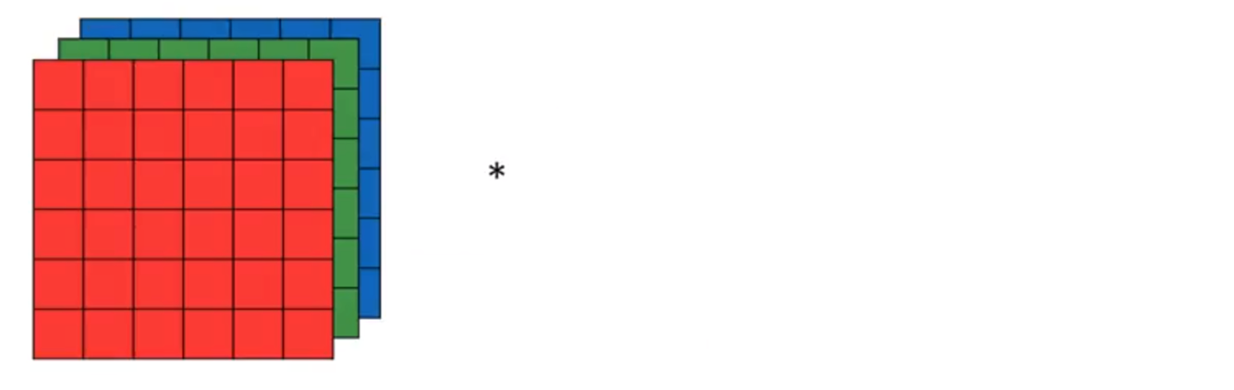
Convolve RGB images

Slide 30
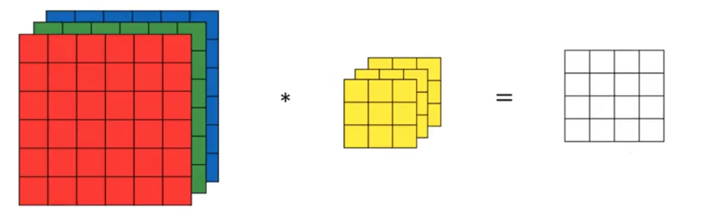
Convolve RGB images

Slide 31
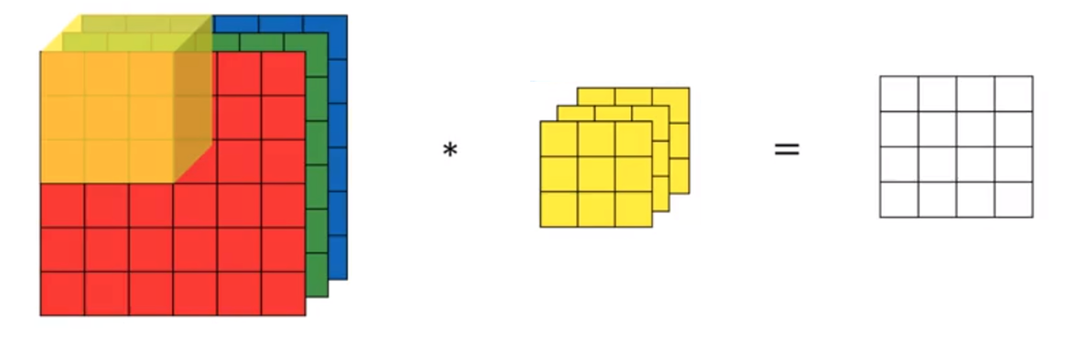
Convolve RGB images

Slide 32
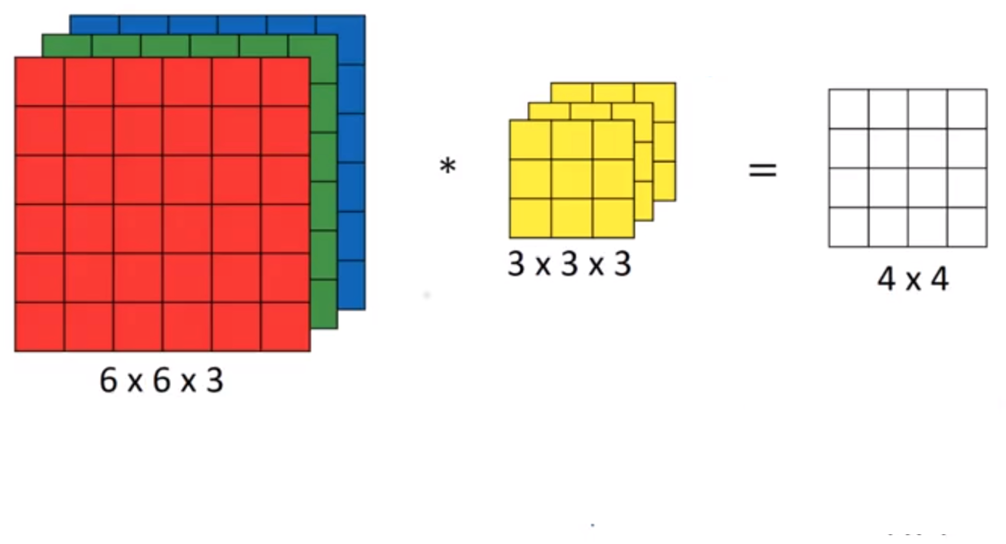
Multiple filters

Slide 33
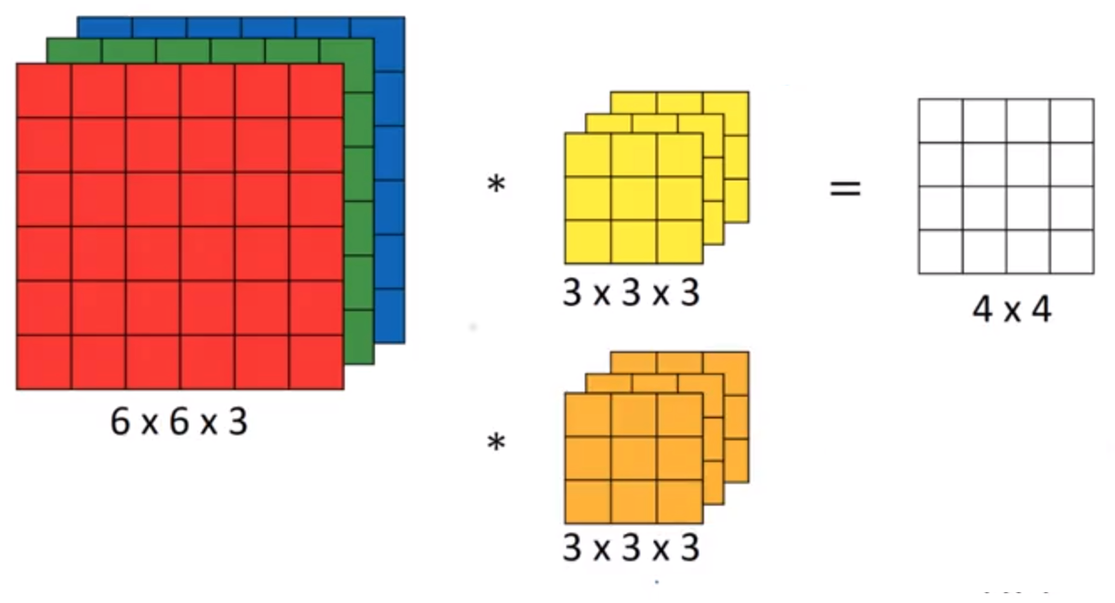
Multiple filters

Slide 34
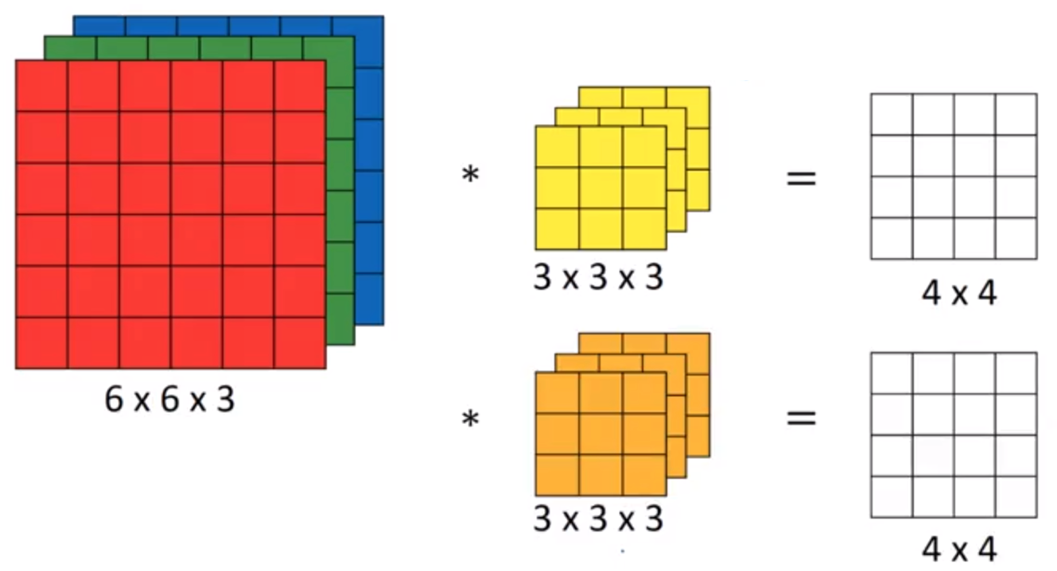
Multiple filters

Slide 35
Multiple filters

Slide 36
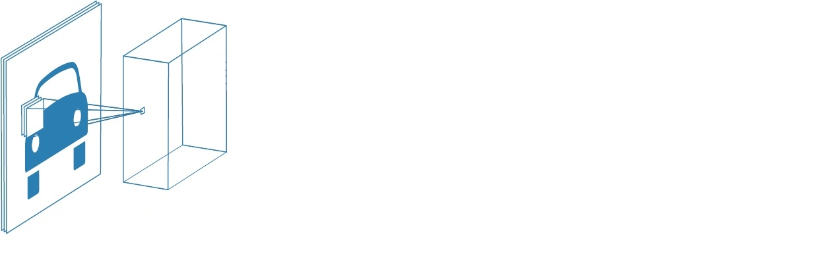

Convolutional Neural Network

Slide 37
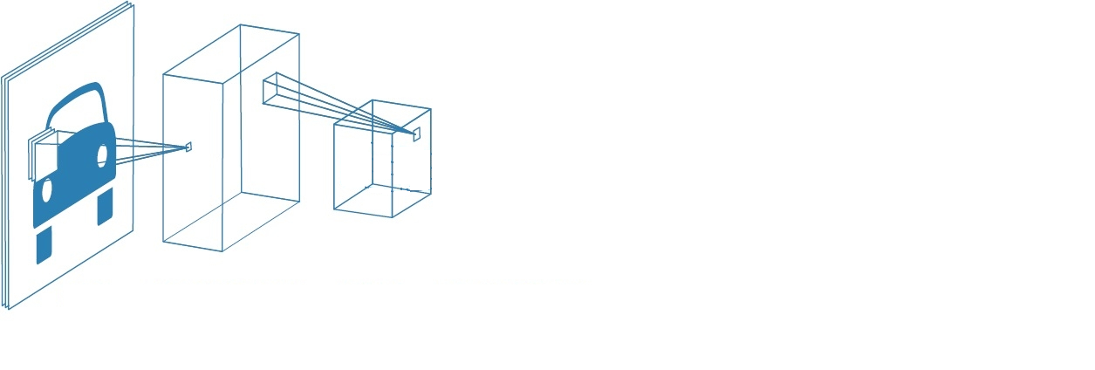
Convolutional Neural Network

Slide 38
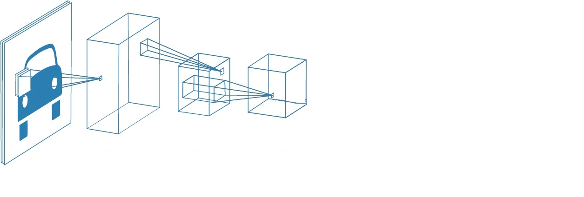
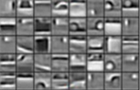
Convolutional Neural Network

Slide 39
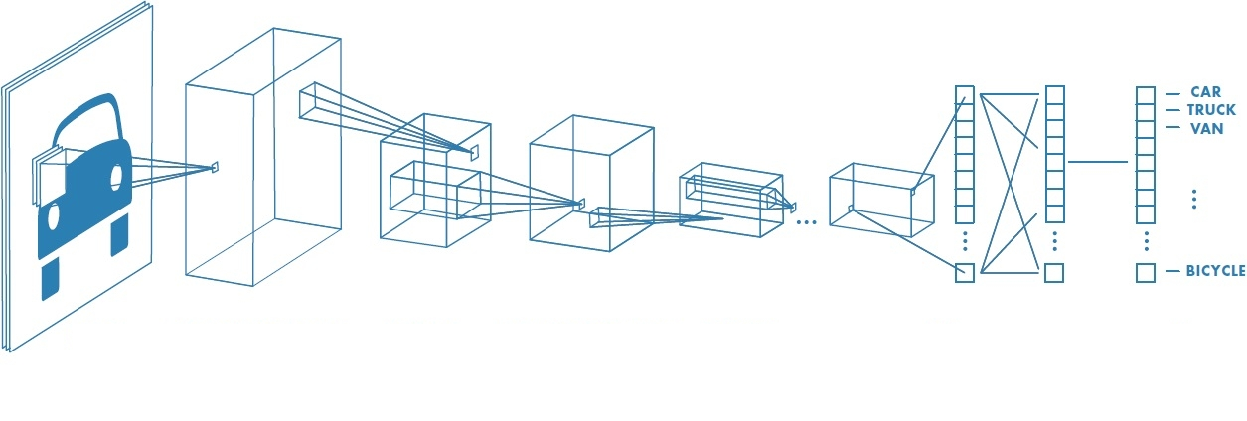
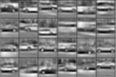
Convolutional Neural Network

Slide 40
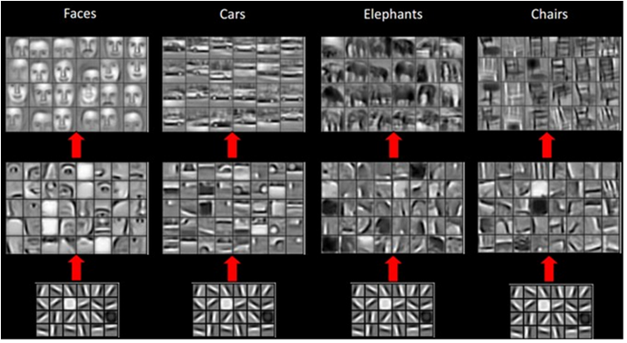
Convolutional Neural Network
CNNs are universal and may be employed for various taks.
Everything depends on data

Slide 41
CNN Details

Slide 42
Padding (1/3)
Convolution operation results in decrease of the image size
The larger is the filter, the greater decrease
It may be a problem if we want to use many layers or blocks
8 | 6 | 2 | 1 | 0 | 3
7 | 4 | 2 | 4 | 4 | 8
3 | 1 | 0 | 8 | 3 | 4
5 | 1 | 3 | 6 | 1 | 5
9 | 6 | 0 | 3 | 2 | 4
6 | 8 | 2 | 9 | 4 | 7
14 | -2 | -3 | -2
10 | -12 | -3 | 1
14 | -9 | -3 | 4
15 | -3 | -2 | 2
1 | 0 | -1
1 | 0 | -1
1 | 0 | -1

Slide 43
Padding (2/3)
Solution: Surround the original image with 0 padding
For 3x3 filter you need 1 pixel padding, for 5x5 filter you need 2 pixel padding, etc
0 | 0 | 0 | 0 | 0 | 0 | 0 | 0
0 | 8 | 6 | 2 | 1 | 0 | 3 | 0
0 | 7 | 4 | 2 | 4 | 4 | 8 | 0
0 | 3 | 1 | 0 | 8 | 3 | 4 | 0
0 | 5 | 1 | 3 | 6 | 1 | 5 | 0
0 | 9 | 6 | 0 | 3 | 2 | 4 | 0
0 | 6 | 8 | 2 | 9 | 4 | 7 | 0
0 | 0 | 0 | 0 | 0 | 0 | 0 | 0
-10 | 11 | 5 | 0 | -6 | 4
-11 | 14 | -2 | -3 | -2 | 7
-6 | 10 | -12 | -3 | 1 | 8
-8 | 14 | -9 | -3 | 4 | 6
-15 | 15 | -3 | -2 | 2 | 7
-14 | 13 | 2 | -4 | -1 | 6
1 | 0 | -1
1 | 0 | -1
1 | 0 | -1

Slide 44
Padding (3/3)
In theory you may use any padding for any image
In practice you are usually using 2 types of padding
Valid – no padding (the image size is reduced)
Same – padding which keeps the dimensions of the image
In Keras:
keras.layers.Conv2D(filters, kernel_size, padding='valid’)
keras.layers.Conv2D(filters, kernel_size, padding=‘same’)

Slide 45
Stride (1/3)
This time we want to reduce the size of convolution output – reduce it faster than with ‘valid’ padding.
Question – Why do we want to do it?
The answer is ‘stride’ – you may try doing bigger steps during convolution operation
8 | 6 | 2 | 1 | 0 | 3
7 | 4 | 2 | 4 | 4 | 8
3 | 1 | 0 | 8 | 3 | 4
5 | 1 | 3 | 6 | 1 | 5
9 | 6 | 0 | 3 | 2 | 4
6 | 8 | 2 | 9 | 4 | 7
14 | -2 | -3 | -2
10 | -12 | -3 | 1
14 | -9 | -3 | 4
15 | -3 | -2 | 2
1 | 0 | -1
1 | 0 | -1
1 | 0 | -1

Slide 46
Stride (2/3)
Stride = 2x2. Make 2 cell steps horizontally and vertically
8 ¹ | 6 ⁰ | 2 ⁻¹ | 1 | 0 | 3
7 ¹ | 4 ⁰ | 2 ⁻¹ | 4 | 4 | 8
3 ¹ | 1 ⁰ | 0 ⁻¹ | 8 | 3 | 4
5 | 1 | 3 | 6 | 1 | 5
9 | 6 | 0 | 3 | 2 | 4
6 | 8 | 2 | 9 | 4 | 7
1 | 0 | -1
1 | 0 | -1
1 | 0 | -1
14
*
=

Slide 47
Convolution Operation
Stride = 2x2. Make 2 cell steps horizontally and vertically
8 | 6 | 2 ¹ | 1 ⁰ | 0 ⁻¹ | 3
7 | 4 | 2 ¹ | 4 ⁰ | 4 ⁻¹ | 8
3 | 1 | 0 ¹ | 8 ⁰ | 3 ⁻¹ | 4
5 | 1 | 3 | 6 | 1 | 5
9 | 6 | 0 | 3 | 2 | 4
6 | 8 | 2 | 9 | 4 | 7
1 | 0 | -1
1 | 0 | -1
1 | 0 | -1
14 | -3
*
=

Slide 48
Stride (2/3)
Stride = 2x2. Make 2 cell steps horizontally and vertically
8 | 6 | 2 | 1 | 0 | 3
7 | 4 | 2 | 4 | 4 | 8
3 ¹ | 1 ⁰ | 0 ⁻¹ | 8 | 3 | 4
5 ¹ | 1 ⁰ | 3 ⁻¹ | 6 | 1 | 5
9 ¹ | 6 ⁰ | 0 ⁻¹ | 3 | 2 | 4
6 | 8 | 2 | 9 | 4 | 7
1 | 0 | -1
1 | 0 | -1
1 | 0 | -1
14 | -3
14
*
=

Slide 49
Stride (2/3)
Stride = 2x2. Make 2 cell steps horizontally and vertically
8 | 6 | 2 | 1 | 0 | 3
7 | 4 | 2 | 4 | 4 | 8
3 | 1 | 0 ¹ | 8 ⁰ | 3 ⁻¹ | 4
5 | 1 | 3 ¹ | 6 ⁰ | 1 ⁻¹ | 5
9 | 6 | 0 ¹ | 3 ⁰ | 2 ⁻¹ | 4
6 | 8 | 2 | 9 | 4 | 7
1 | 0 | -1
1 | 0 | -1
1 | 0 | -1
14 | -3
14 | ?
*
=

Slide 50
Stride (2/3)
Stride = 2x2. Make 2 cell steps horizontally and vertically
8 | 6 | 2 | 1 | 0 | 3
7 | 4 | 2 | 4 | 4 | 8
3 | 1 | 0 ¹ | 8 ⁰ | 3 ⁻¹ | 4
5 | 1 | 3 ¹ | 6 ⁰ | 1 ⁻¹ | 5
9 | 6 | 0 ¹ | 3 ⁰ | 2 ⁻¹ | 4
6 | 8 | 2 | 9 | 4 | 7
1 | 0 | -1
1 | 0 | -1
1 | 0 | -1
14 | -3
14 | -3
*
=

Slide 51
Stride (3/3)
Usually we are using square stride (1x1 or 2x2). However it is not necessary
In Keras:
keras.layers.Conv2D(filters, kernel_size, strides=(1, 1))
keras.layers.Conv2D(filters, kernel_size, strides=(2, 2))

Slide 52
Max Pooling
We use max pooling to reduce the size of image
Usually we use max pooling with the stride 2x2, and the window size 2x2
8 | 6 | 2 | 1 | 0 | 3
7 | 4 | 2 | 4 | 4 | 8
3 | 1 | 0 | 8 | 3 | 4
5 | 1 | 3 | 6 | 1 | 5
9 | 6 | 0 | 3 | 2 | 4
6 | 8 | 2 | 9 | 4 | 7
Pooling

Slide 53
Max Pooling
8 | 6 | 2 | 1 | 0 | 3
7 | 4 | 2 | 4 | 4 | 8
3 | 1 | 0 | 8 | 3 | 4
5 | 1 | 3 | 6 | 1 | 5
9 | 6 | 0 | 3 | 2 | 4
6 | 8 | 2 | 9 | 4 | 7
8
Pooling

Slide 54
Max Pooling
8 | 6 | 2 | 1 | 0 | 3
7 | 4 | 2 | 4 | 4 | 8
3 | 1 | 0 | 8 | 3 | 4
5 | 1 | 3 | 6 | 1 | 5
9 | 6 | 0 | 3 | 2 | 4
6 | 8 | 2 | 9 | 4 | 7
8 | 4
Pooling

Slide 55
Max Pooling
8 | 6 | 2 | 1 | 0 | 3
7 | 4 | 2 | 4 | 4 | 8
3 | 1 | 0 | 8 | 3 | 4
5 | 1 | 3 | 6 | 1 | 5
9 | 6 | 0 | 3 | 2 | 4
6 | 8 | 2 | 9 | 4 | 7
8 | 4 | 8
Pooling

Slide 56
Max Pooling
8 | 6 | 2 | 1 | 0 | 3
7 | 4 | 2 | 4 | 4 | 8
3 | 1 | 0 | 8 | 3 | 4
5 | 1 | 3 | 6 | 1 | 5
9 | 6 | 0 | 3 | 2 | 4
6 | 8 | 2 | 9 | 4 | 7
8 | 4 | 8
5
Pooling

Slide 57
Max Pooling
8 | 6 | 2 | 1 | 0 | 3
7 | 4 | 2 | 4 | 4 | 8
3 | 1 | 0 | 8 | 3 | 4
5 | 1 | 3 | 6 | 1 | 5
9 | 6 | 0 | 3 | 2 | 4
6 | 8 | 2 | 9 | 4 | 7
8 | 4 | 8
5 | 8 | 5
9 | 9 | ?
Pooling

Slide 58
Max Pooling
8 | 6 | 2 | 1 | 0 | 3
7 | 4 | 2 | 4 | 4 | 8
3 | 1 | 0 | 8 | 3 | 4
5 | 1 | 3 | 6 | 1 | 5
9 | 6 | 0 | 3 | 2 | 4
6 | 8 | 2 | 9 | 4 | 7
8 | 4 | 8
5 | 8 | 5
9 | 9 | 7
Pooling

Slide 59
Max Pooling - Summary
Max Pooling is used for reducing the size of layers (reducing the number of parameters
Typical filter size: 2x2
Typical stride: 2x2
Max Pooling does not have any parameters! There is nothing to train.
There are also other versions (such as average pooling) but for CNN Max Pooling usually is the best choice.
keras.layers.MaxPooling2D(pool_size=(2, 2), strides=None, padding='valid', data_format=None)
keras.layers.MaxPooling2D()

Slide 60
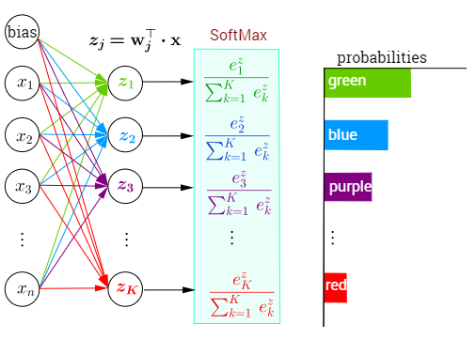
SoftMax
SoftMax is a technique used for multi-class classification
In the final layer you need 1 neuron for each class
Softmax returns the probability that the tested image belongs to the particular class
Softmax is connected with special loss function categorical crossentropy
'))
Softmax in Keras:
model.add(Dense(10, activation='softmax’))
model.compile(loss='categorical_crossentropy’, optimizer='adam’)

Slide 61
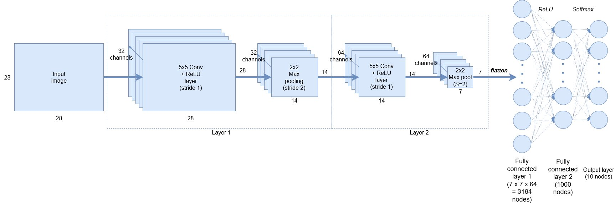
CNN example
* From Keras tutorial

Slide 62
Thank you Q & A psekula@umd.edu

